Slide 1


Subtopic N3.1 - Properties of Multiplication and Division
LEARNING OUTCOME: To understand the properties of multiplication and division.
Objectives:
Keywords:
Multiplication
Division
Product
Share
To visually represent multiplication and division.
To use bar models to write multiplication and division.
Introduction – read and annotate:
In this subtopic, we’ll explore the properties of multiplication and division that help us understand how
numbers work together. We'll look at fact families, which show how multiplication and division are
connected, just like addition and subtraction. You'll also revisit the commutative property—where the
order of numbers doesn't change the result—and see how it applies to multiplication but not to
division. These properties are key to solving problems such as area, square and cube numbers, and
order of operations. Understanding how multiplication and division work together will strengthen your
overall number sense and prepare you for more complex maths.
Definition
Characteristics
Repeated addition of the same number.
Often represented by the "×" sign.
Commutative
Distributive property: Multiplication can be distributed over addition. For example, 3 × (2 + 4) is the same as (3 × 2) + (3 × 4), and both equal 18
Examples
Multiplication
Non - Examples
If you have 3 groups of 4 apples, you can use multiplication to find the total number of apples by calculating 3 × 4, which equals 12.
Sarah has 12 cookies. She wants to share them equally among 4 friends. How many cookies will each friend get? This is a division problem.
Properties of multiplication
Example 1 - I do
Write the multiplication facts from the bar models and array given
4 3 12 3 4 12

Slide 2





Example 2 – We do
Write the multiplication facts from the bar model and array given
Why does this example only have one bar model and one multiplication fact? Because it is the same number multiplied by itself (3) to make 9.
3 3 9
Example 3 – You do
Write the multiplication facts from the bar model and array given
2 3 6 3 2 6
Independent Practice
1. Write the multiplication facts from the bar models or arrays given
Question | Representations | Multiplication Facts
a)
2 5 10 5 2 10

Slide 3









Question | Representations | Multiplication Facts
b)
c)
d)
e)
f)
2 10 20
10 2 20
4 5 20
5 4 20
3 10 20
10 3 30
15 2 30
2 15 30
5 6 30
6 5 30

Slide 4


Question | Representations | Multiplication Facts
g)
h)
i)
2. For the following questions, complete the bar models and write the multiplication facts.
Question | Bar Model | Multiplication Facts
a)
b)
c)
2 8 16
8 2 16
16
4 | 4 | 4 | 4
4 4 16
4 4 16
24
2 | 2 | 2 | 2 | 2 | 2 | 2 | 2 | 2 | 2 | 2 | 2
12 2 24
2 12 24
24
12 | 12
24
6 | 6 | 6 | 6
4 6 24
6 4 24
24
4 4 4 4 4 4
40
4 | 4 | 4 | 4 | 4 | 4 | 4 | 4 | 4 | 4
10 4 40
4 10 40
40
10 10 10 10
18
3 | 3 | 3 | 3 | 3 | 3
6 3 18
3 6 18
6 6 6

Slide 5





Question | Bar Model | Multiplication Facts
d)
e)
3. For the following questions, use the one bar model to deduce both multiplication facts.
a)
b)
c)
d)
e)
7 3 21
3 7 21
21
4 8 32
8 4 32
32
35
7 | 7 | 7 | 7 | 7
5 7 35
7 5 35
45
9 | 9 | 9 | 9 | 9
5 9 45
9 5 45
49
7 | 7 | 7 | 7 | 7 | 7 | 7
7 7 49
7 7 49
3 8 24
8 3 24
63
9 | 9 | 9 | 9 | 9 | 9 | 9
7 9 63
9 7 63

Slide 6
Definition
Characteristics
Division is the arithmetical process of dividing one number into another number.
Involves two numbers: dividend and divisor.
The result of division is called the quotient.
Can result in a whole number, a fraction, or a decimal, depending on the numbers involved.
Denoted by the symbol "÷" or the fraction bar "⁄“
Not commutative
Examples
Division
Non - Examples
10 ÷ 2 = 5
8 ÷ 4 = 2
21 ÷ 7 = 3
1.5 ÷ 0.5 = 3
Addition & subtraction are not division operations.
Multiplication is the inverse of division but is a different operation.
Ratios and proportions are related concepts but are not division.
Properties of division
Example 4 - I do
Write the division facts from the bar model and array given
12
3 | 3 | 3 | 3
12 4 3
12 3 4
12
4 | 4 | 4
Example 5 - We do
Write the division facts from the bar model and array given
Why does this example only have one bar model and one multiplication fact? Because the divisor is the same as the answer, so writing it the other way would be the same.
9
3 | 3 | 3
9 3 3

Slide 7






Example 6 - You do
Write the division facts from the bar model and array given
24
6 | 6 | 6 | 6
24 4 6
24 6 4
24
4 | 4 | 4 | 4 | 4 | 4
Independent Practice
4. Write the division facts from the representations given
Question | Representations | Division Facts
a)
b)
c)
18 9 2
18 2 9
18 6 3
18 3 6
15 3 5
15 5 3

Slide 8


d)
e)
f)
25
5 | 5 | 5 | 5 | 5
25 5 5
42 7 6
42 6 7
30 6 5
30 5 6

Slide 9
5. For the following questions, use the one bar model to deduce both division facts.
Question | Bar Model | Division Facts
a)
b)
c)
d)
e)
f)
g)
h)
i)
10
1 | 1 | 1 | 1 | 1 | 1 | 1 | 1 | 1 | 1
10 10 1
10 1 10
10
10
10 1 10
10 10 1
10
2 | 2 | 2 | 2 | 2
10 5 2
10 2 5
5
1 | 1 | 1 | 1 | 1
5 5 1
5 1 5
100
10 | 10 | 10 | 10 | 10 | 10 | 10 | 10 | 10 | 10
100 10 10
100 10 10
24
2 | 2 | 2 | 2 | 2 | 2 | 2 | 2 | 2 | 2 | 2 | 2
24 12 2
24 2 12
24
4 | 4 | 4 | 4 | 4 | 4
24 6 4
24 4 6
27
9 | 9 | 9
27 3 9
27 9 3
63
7 | 7 | 7 | 7 | 7 | 7 | 7 | 7 | 7
63 9 7
63 7 9

Slide 10
Number families with multiplication and division
Example 7 - I do | Example 8 - We do | Example 9 - You do…
Write the number families from the bar models given
10
5 | 5
14
2 | 2 | 2 | 2 | 2 | 2 | 2
20
4 | 4 | 4 | 4 | 4
2 5 10
5 2 10
7 2 14
2 7 14
5 4 20
4 5 20
10 2 5
10 5 2
14 7 2
14 2 7
20 5 4
20 4 5
Independent Practice.
6. Write the number families from the bar models given
a)
b)
c)
d)
60
12 | 12 | 12 | 12 | 12
36
9 | 9 | 9 | 9
6
2 | 2 | 2
4
1 | 1 | 1 | 1
5 12 60
12 5 60
4 9 36
9 4 36
3 2 6
2 3 6
4 1 4
1 4 4
60 5 12
60 12 5
36 4 9
36 9 4
6 3 2
6 2 3
4 4 1
4 1 4
e)
f)
g)
h)
45
9 | 9 | 9 | 9 | 9
45
5 | 5 | 5 | 5 | 5 | 5 | 5 | 5 | 5
64
8 | 8 | 8 | 8 | 8 | 8 | 8 | 8
28
7 | 7 | 7 | 7
5 9 45
9 5 45
9 5 45
5 9 45
8 8 64
8 8 64
4 7 28
7 8 28
45 5 9
45 9 5
45 9 5
45 5 9
64 8 8
64 8 8
28 4 7
28 7 4

Slide 11
i)
j)
k)
l)
40
5 | 5 | 5 | 5 | 5 | 5 | 5 | 5
40
10 | 10 | 10 | 10
16
2 | 2 | 2 | 2 | 2 | 2 | 2 | 2
16
8 | 8
8 5 40
5 8 40
4 10 40
10 4 40
8 2 16
2 8 16
2 8 16
8 2 16
40 8 5
40 5 8
40 4 10
40 10 4
16 2 8
16 8 2
16 2 8
16 8 2
m)
n)
o)
p)
36
12 | 12 | 12
36
6 | 6 | 6 | 6 | 6 | 6
3
1 | 1 | 1
3
3
3 12 36
12 2 36
6 6 36
6 6 36
3 1 3
1 3 3
1 3 3
3 1 3
36 3 12
36 12 3
36 6 6
36 6 6
3 3 1
3 1 3
3 1 3
3 3 1
q)
r)
s)
t)
54
6 | 6 | 6 | 6 | 6 | 6 | 6 | 6 | 6
21
3 | 3 | 3 | 3 | 3 | 3 | 3
90
9 | 9 | 9 | 9 | 9 | 9 | 9 | 9 | 9 | 9
72
8 | 8 | 8 | 8 | 8 | 8 | 8 | 8 | 8
9 6 54
6 9 54
7 3 21
3 7 21
10 9 90
9 10 90
9 8 72
8 9 72
54 9 6
54 6 9
21 7 3
21 3 7
90 10 9
90 9 10
72 9 8
72 8 9

Slide 12
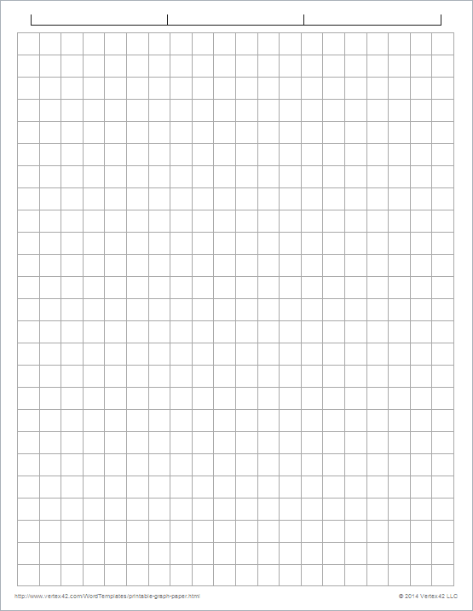
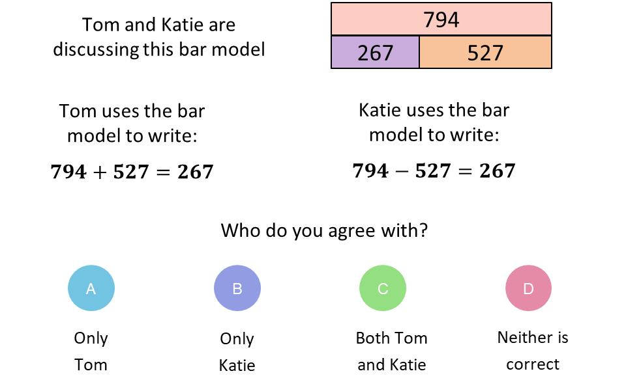
Skills Check
1.
2.
40
8 | 8 | 8 | 8 | 8
27
9 | 9 | 9
Deduce both multiplication facts from this bar model
Deduce both division facts from this bar model
27 3 9
27 9 3
x
÷
5 8 40
8 5 40
x
÷
3. Which calculation is missing from the number
family?
4.
5 x 6 = 30
6 x 5 = 30
30 ÷ 6 = 5
20
4 | 4 | 4 | 4
4 x 5 = 20
20 ÷ 5 = 4
30 ÷ 5 = 6
5 ÷ 6 = 30
c) 6 ÷ 5 = 30
d) 30 ÷ 6 = 5

